Slide 1
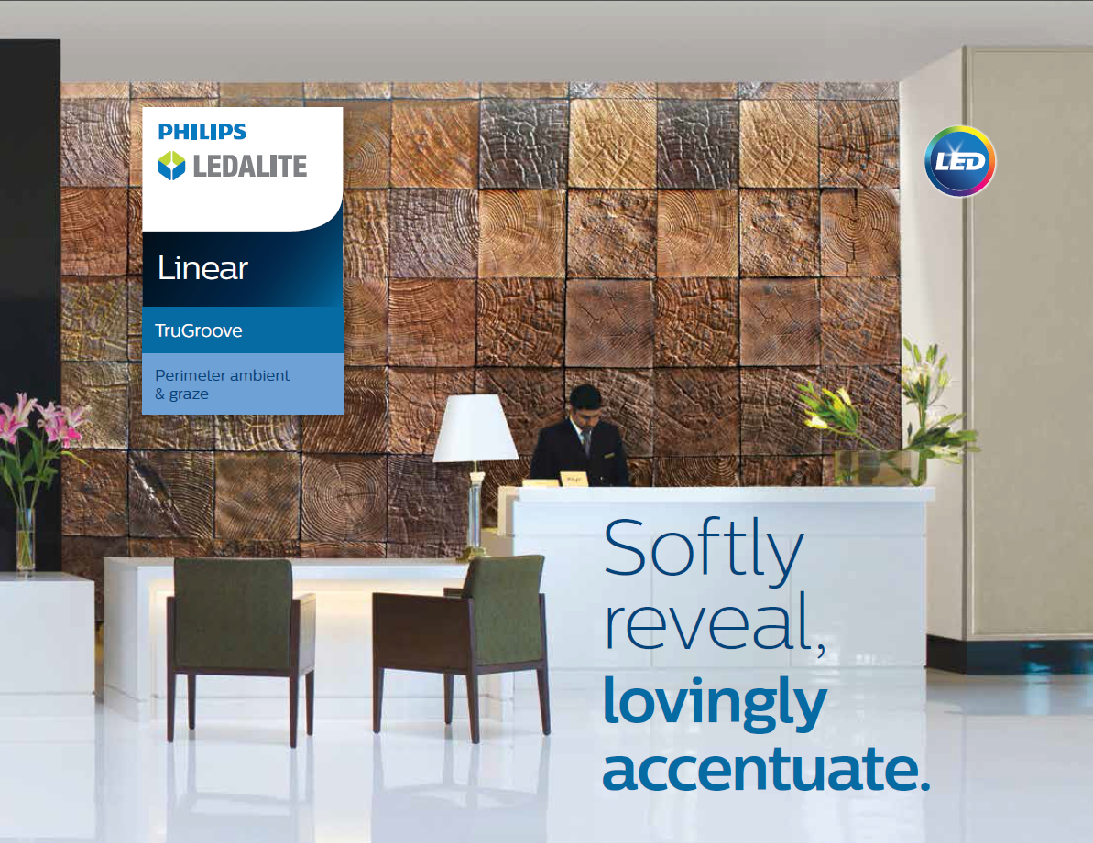


Slide 2
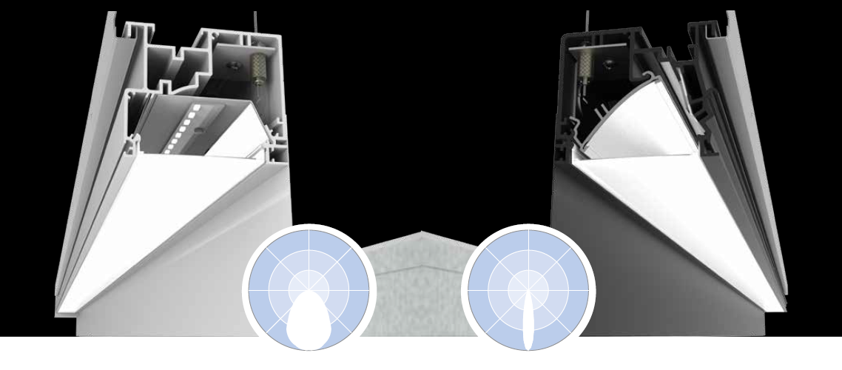
Ambient Graze

Slide 3


Why TruGroove Perimeter?
Graze Version
Dramatic reverse parabolic optic
8:1 uniformity on a 9’ wall
Efficacies up to 113 LPW
Ambient Version
Gentle wall illumination and room fill with MesoOptics®
Affordable & easy to install
(for a wall/slot)
Outputs up to 4200lm/4ft
Efficacies up to 115 LPW

Slide 4
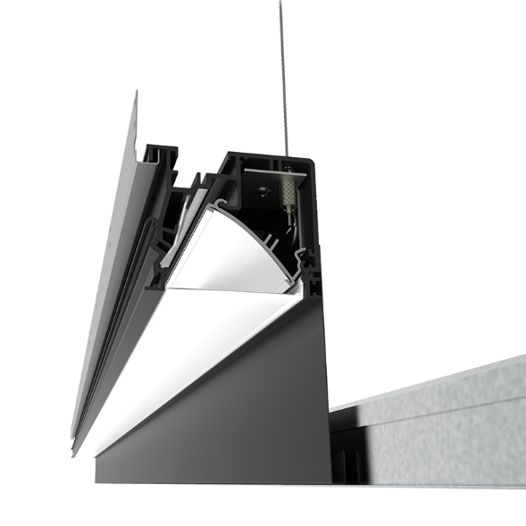
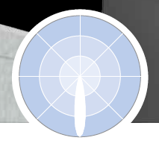
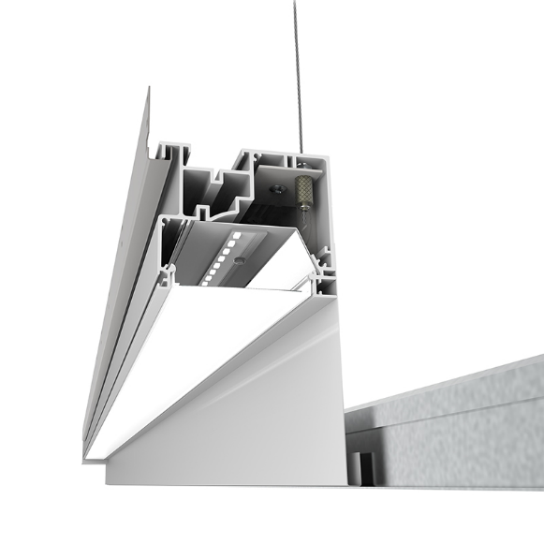
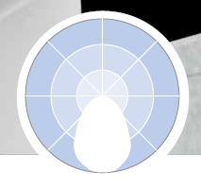
TruGroove Perimeter – Optics & Distributions
Graze
LED array angled away from the wall
Novel reverse parabolic optic efficiently focuses light into a tight linear beam
Flush frosted lens softens edges
Flexible enough to handle textures from 1/16” to 1” deep
Ambient
LED array pointed downward
Flush MesoOptics® lens smooths and controls light in both axes
No telescoping or tapered optics needed
Top few feet of wall provides an ambient glow and bounces fill light into the space
Workplane or floor illumination up to 8ft from a 9ft wall

Slide 5
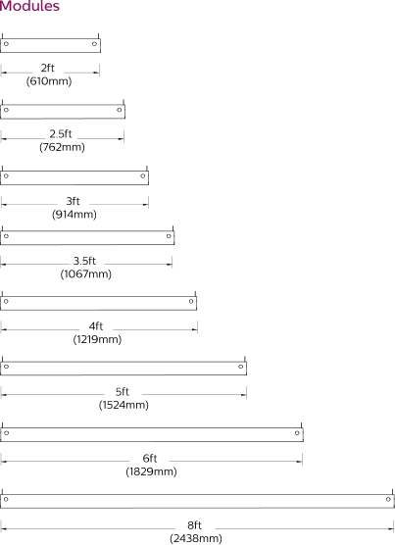
TruGroove Perimeter – Module Options
Modules
Lumen Packages
Nominal lumen outputs
Color Temp
3000K, 3500K, 4000K (CRI >80)
Wiring & Controls
EM Wiring & EM Battery Pack in Ambient version
Output /4ft | Output /ft | Power /4ft | Power /ft
4100 lm | 1025 lm | 39.7 W | 9.9 W
3000 lm | 750 lm | 27.9 W | 7.0 W
2100 lm | 525 lm | 19.3 W | 4.8 W
1400 lm | 350 lm | 13.2 W | 3.3 W

Slide 6
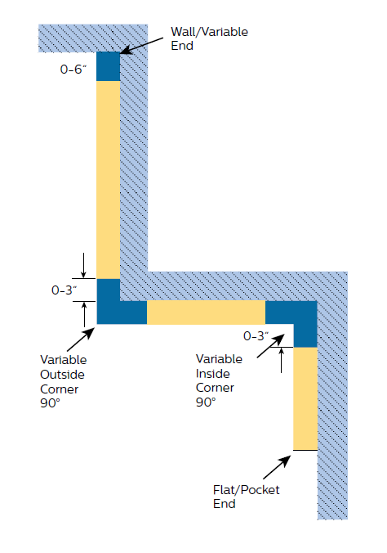
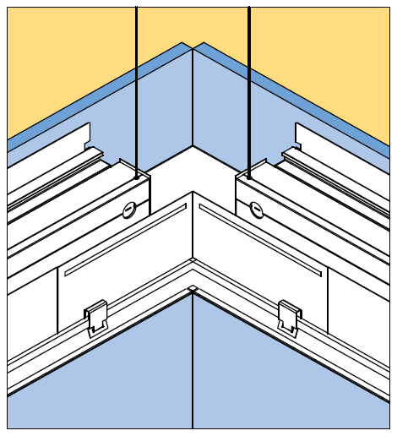
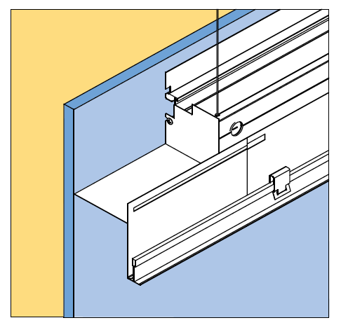
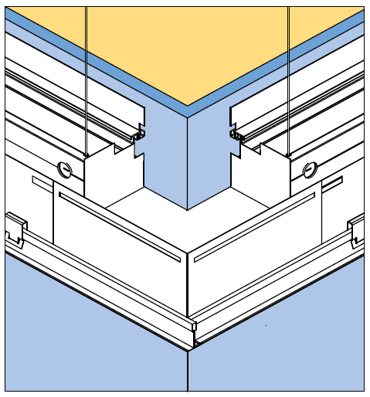
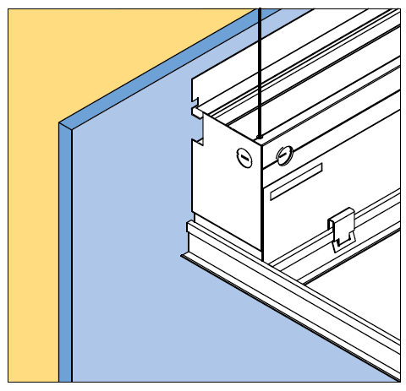
TruGroove Perimeter – Runs & Patterns
Pattern

Slide 7
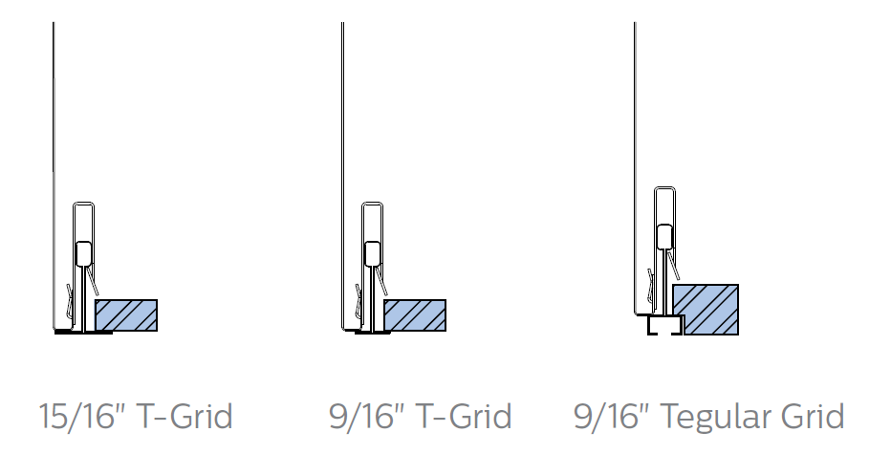
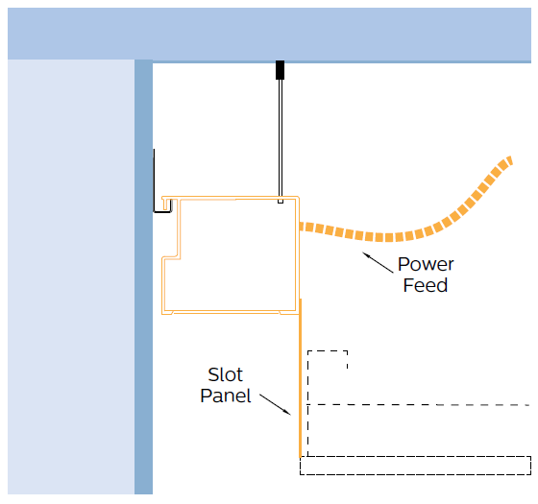
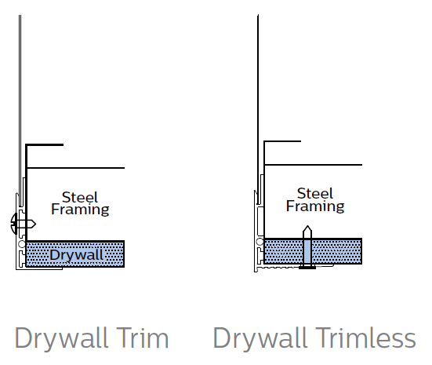
TruGroove Perimeter – Slot & Trim
Slot Panel
4” or 1¾” panel height
(5” overall height for low plenum)
Air return option in 4” grid version
Ceiling Trim
Cable
Rail
Wall
Slot Panel (4” or 1¾”)
Ceiling Frame
Trim

Slide 8
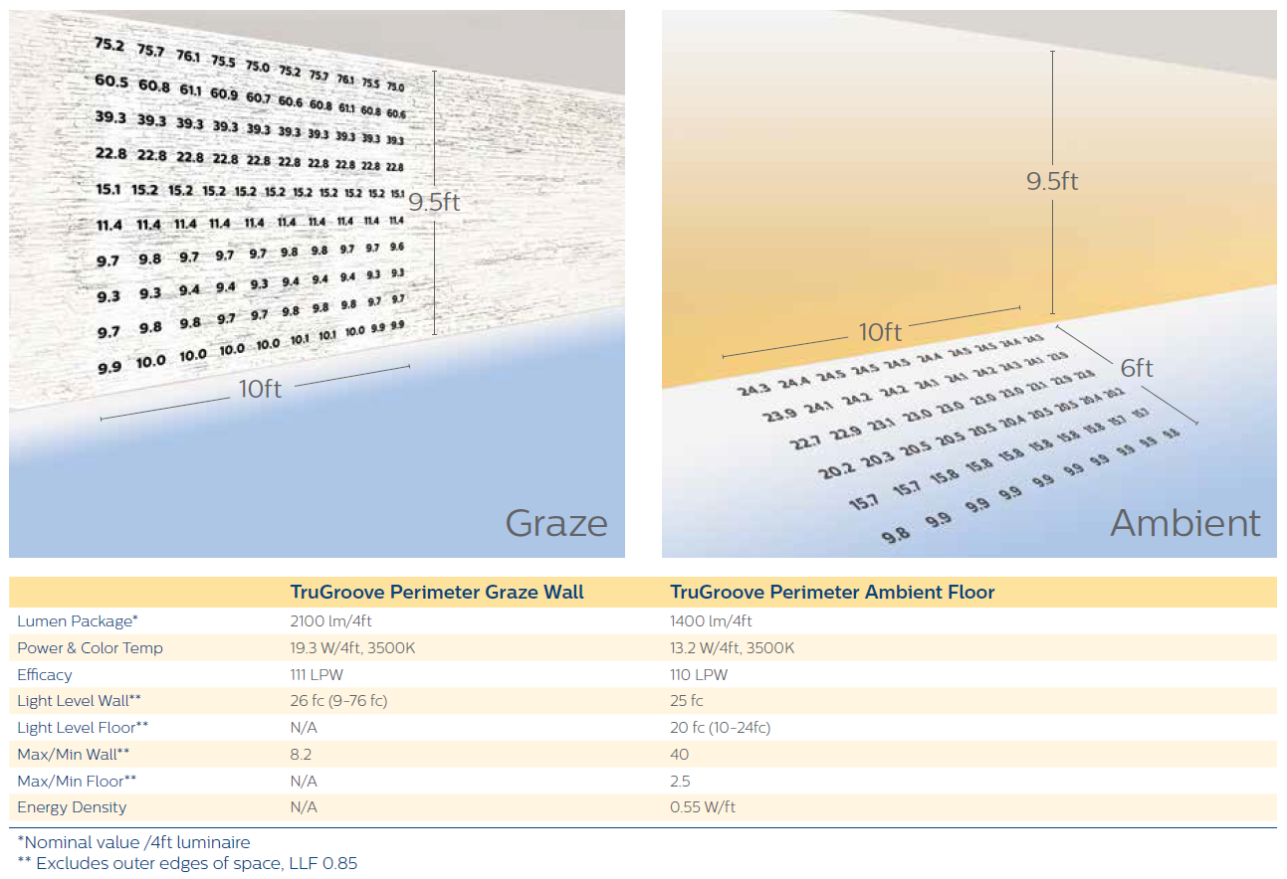
Applications
Typical 9.5’ Wall
Key segments
Office
Hospitality
Healthcare

Slide 9
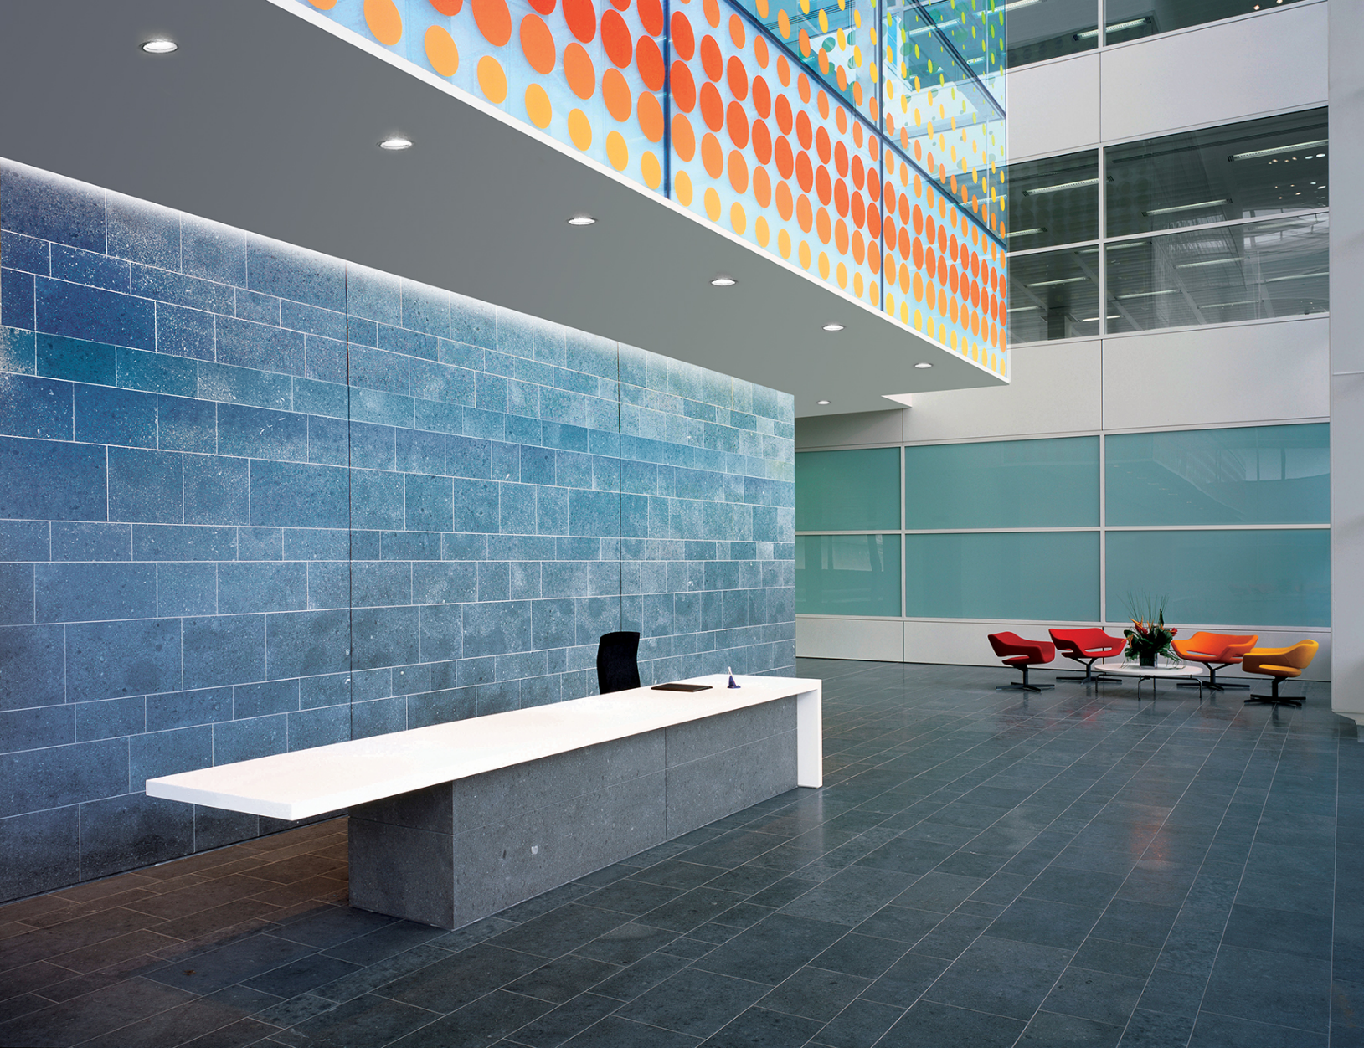
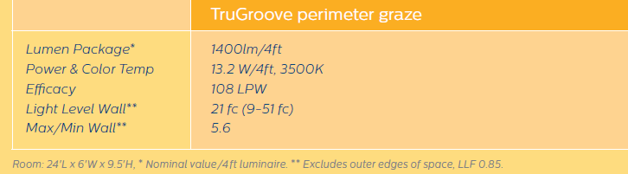
Applications Lobby

Slide 10
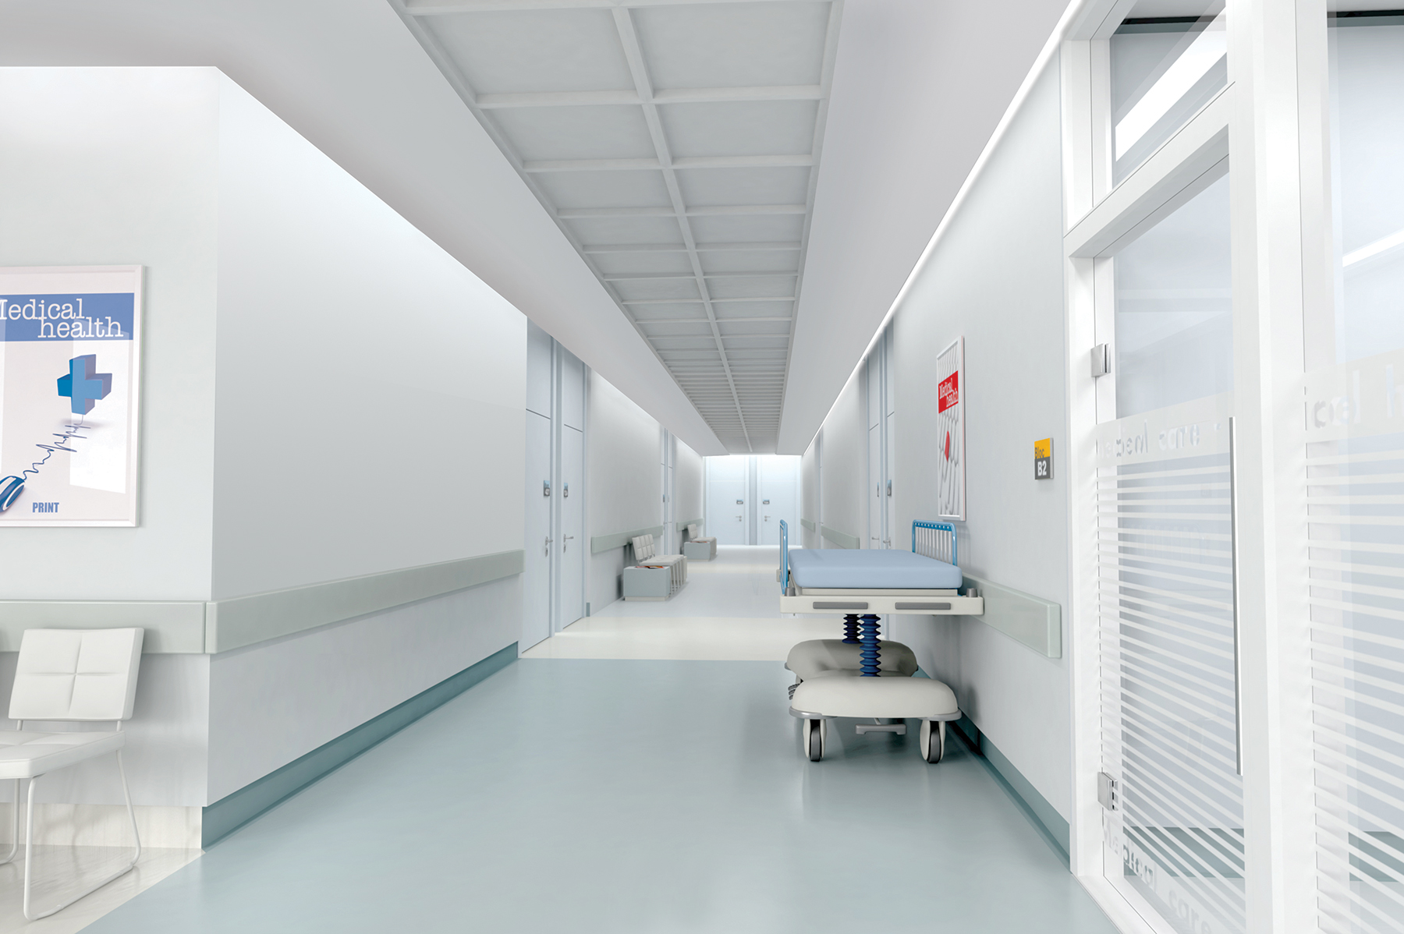
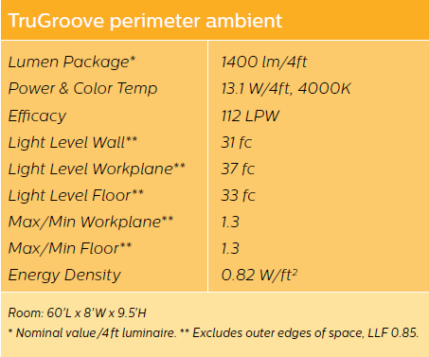
Applications Corridor

Slide 11
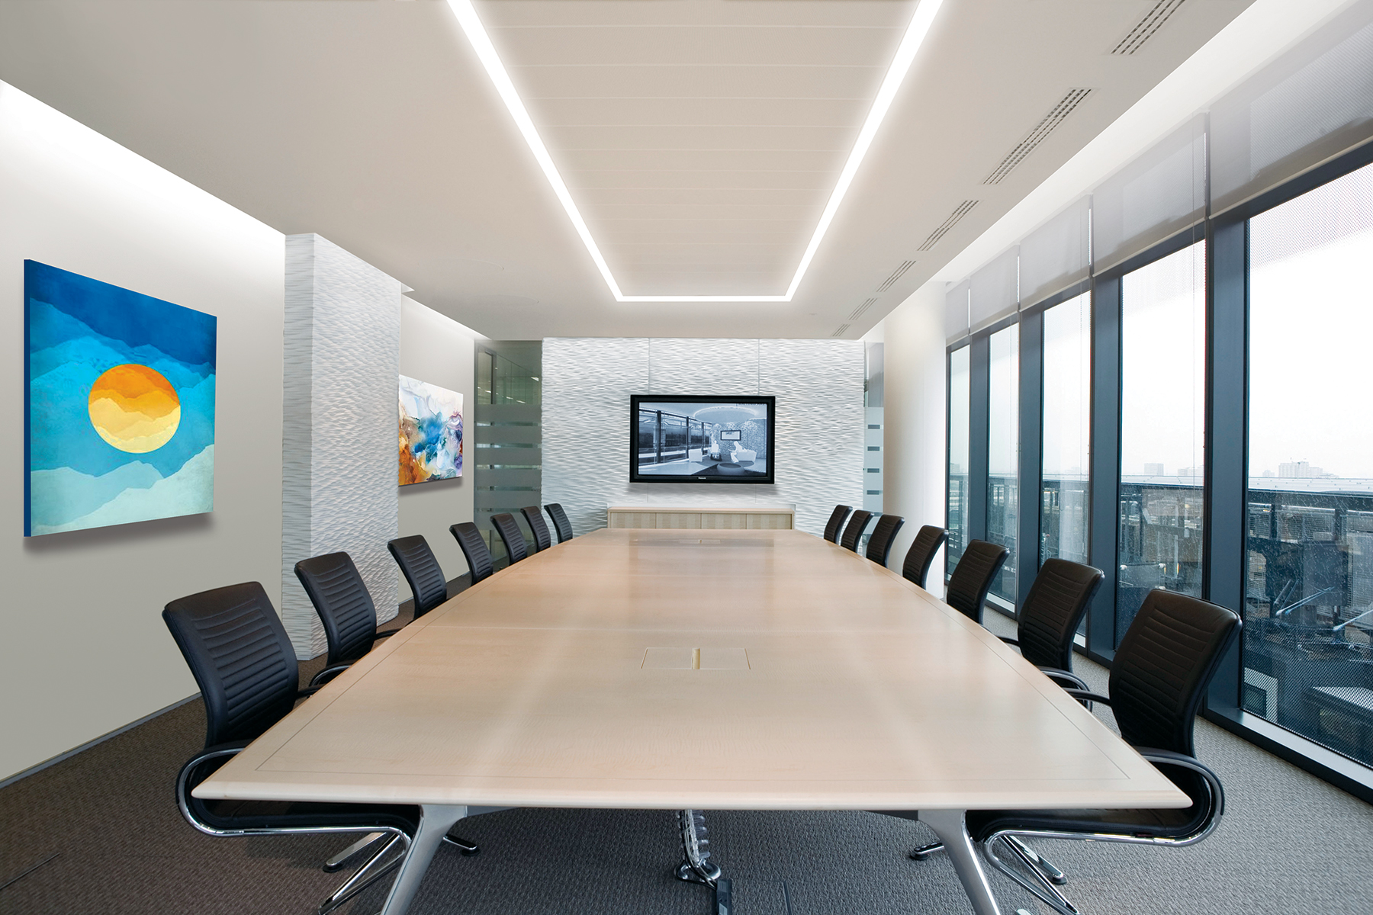
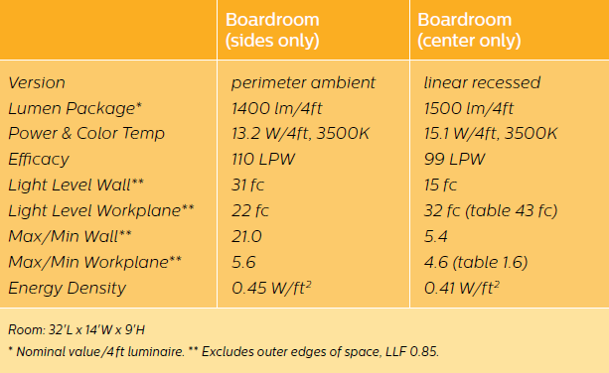
Applications Boardroom

Slide 12
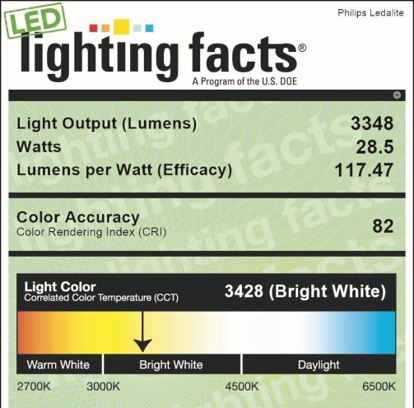
TruGroove Perimeter Certifications
Lighting Facts
IESNA LM-79 and LM-80 tested
Lumen Maintenance
  L₈₀ (12k) > 72,000 hrs
No DLC category for perimeter

Slide 13
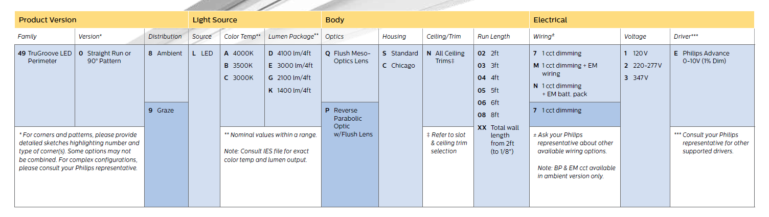
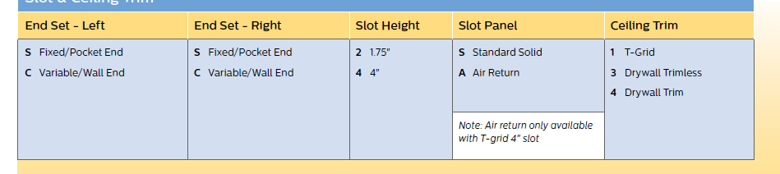
TruGroove Perimeter Order Guide
Modules
Slot & Ceiling Trim
For patterns, submit a drawing or sketch to avoid confusion

