Slide 1
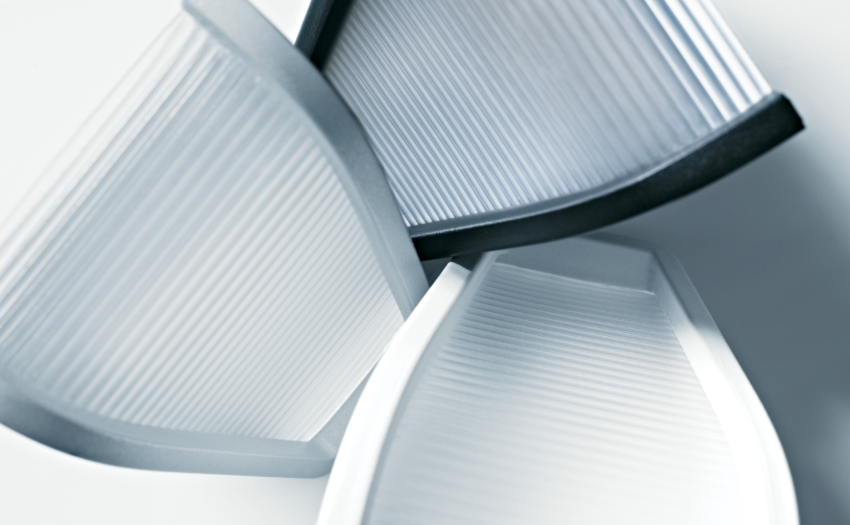

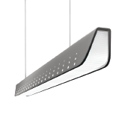
Notes:
Welcome to the general sales presentation for Jump LED upgrade.
This presentation provides a recap of the main features of existing Jump LED, as well as new elements of this major upgrade and unique selling points.

Slide 2
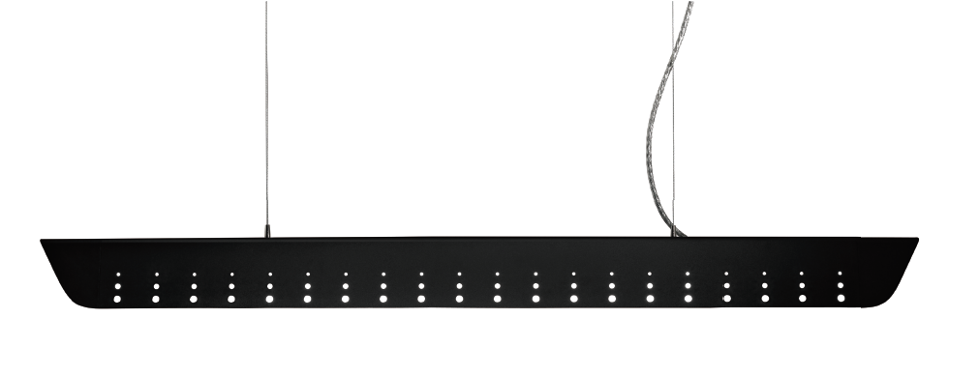


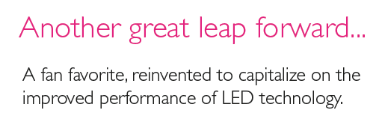
Notes:
At its initial launch in 2011, Jump was a ground-breaking product, but LED technology was still in its infancy. This major product upgrade leverages the rapid development of LEDs to take the product to a new level, now significantly out-performing T5 fluorescent variants.

Slide 3
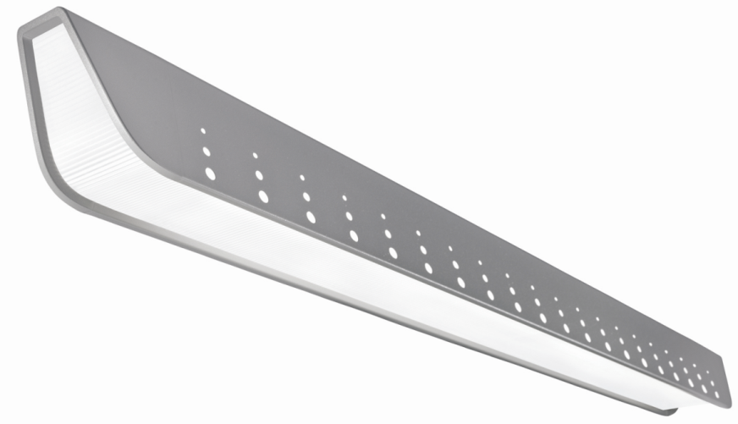

What Jump already offers
Award-winning aesthetics – Red Dot Design Award
Uninterrupted continuum of luminance
  Textured MesoOptics lens
  Revolutionary luminous endcap
First LED linear direct luminaire with a batwing distribution
Best in class lighting performance
  Distribution, surface uniformity, energy density,
  glare control & spacing
  Symmetric & asymmetric distributions
Modular & integrated – Airwave Wireless and Response Daylight controls
Notes:
Key Jump competitive strengths (existing): Aesthetics, lighting performance with control, options, build quality

Slide 4
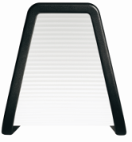
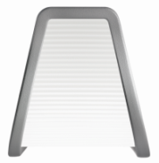
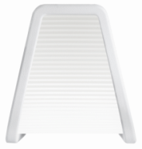
Aesthetic Options
SplashPerf, Black
PixelPerf, Titanium
SolidSide, White
Notes:
Jump is available in 3 housing aesthetics. SplashPerf is bold and contemporary and, even when sections are joined together, gives a continuous, uninterrupted pattern along the entire length; PixelPerf delivers a touch of sophisticated visual interest; while SolidSide is the purest form.
There are also 3 signature colors: Titanium Silver, Black and White – at no additional charges or set-up fees. All the finishes are matte textured and thermally cured polyester powder coatings that give the soft exterior envelope a subtle texture and depth. The Titanium Silver version adds just a hint of metallic flake to give the right amount of sparkle.

Slide 5
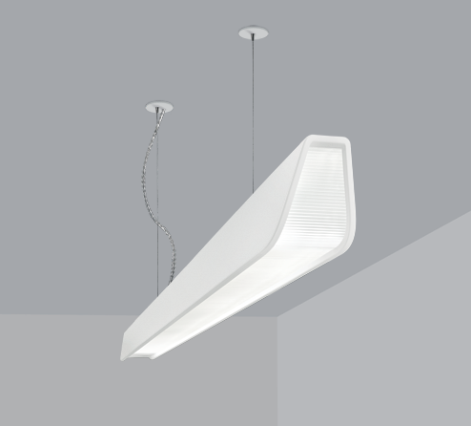
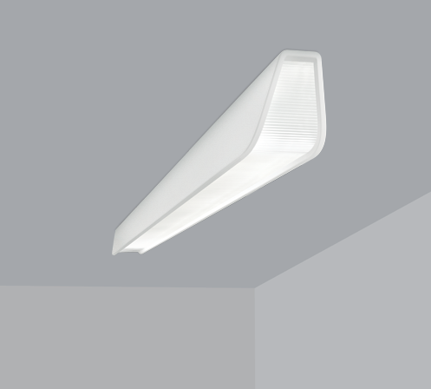
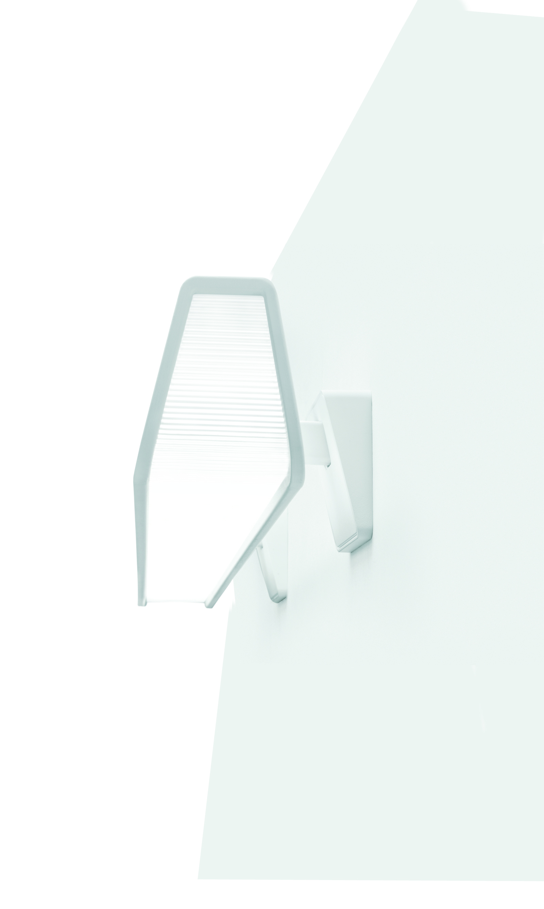
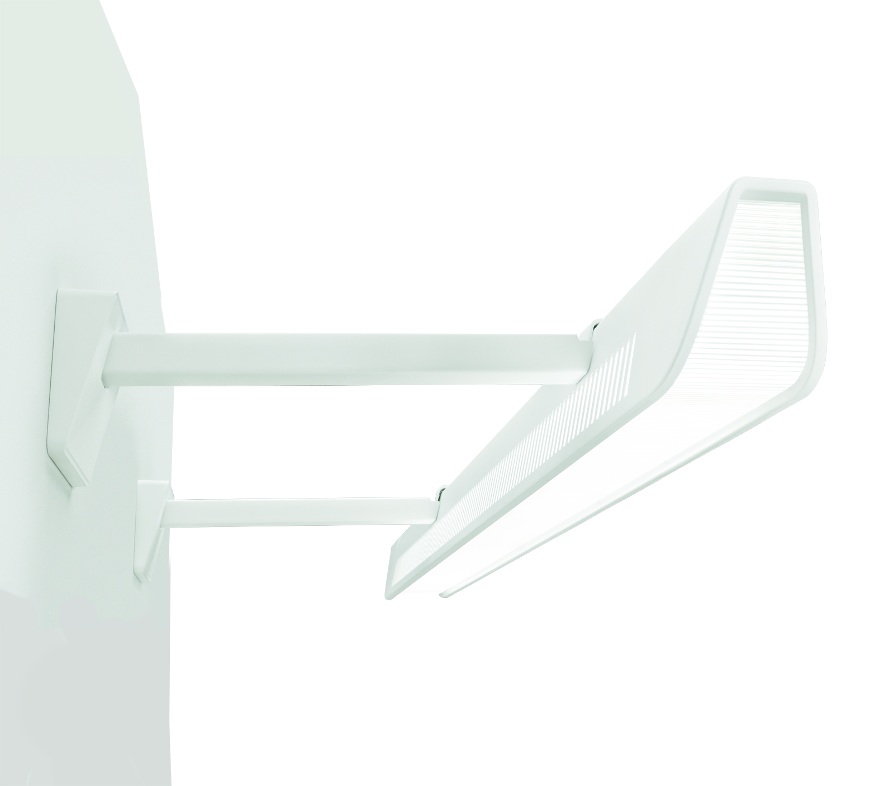
Mount Options
Suspended Surface mount
Cantilever mount Wall mount
Notes:
Suspended, surface, and wall mounted versions allow Jump to be integrated in almost any architectural environment or application where direct lighting is required.

Slide 6
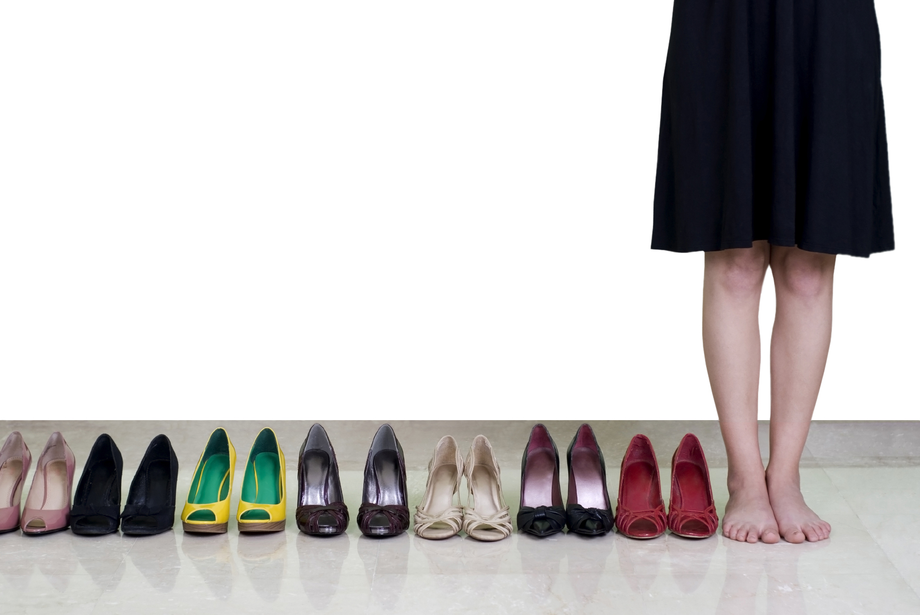
Endless Possibilities
1,040 available combinations!
Notes:
Jump provides design freedom unlike anything else in the market. With all the possible combinations of styles, distributions, light sources, colors, patterns, Jump is available in over one thousand physical configurations (plus electrical options). Designers can mix and match the multitude of options and create the perfect blend to fit every area of a project.

Slide 7
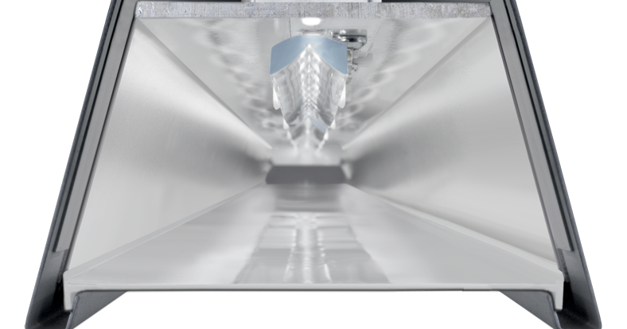
Optics
Biconvex Lens
Miro silver reflectors
Downlight from the LED array
is redirected laterally with a biconvex lens
98% efficient Miro silver reflectors mix the light in the optical chamber
MesoOptics holographic film shapes the beam into an optimal batwing distribution
MesoOptics holographic film
Batwing Distribution
Notes:
How it works: Biconvex lens + highly efficient reflectors + MesoOptics = Batwing distribution
Truly innovative leading edge design integrates technology and aesthetics with advanced mechanical, electronic, and thermal engineering.
This results in a highly efficacious luminaire with consistent color along a textured continuum of luminance with no direct view of the light source.

Slide 8
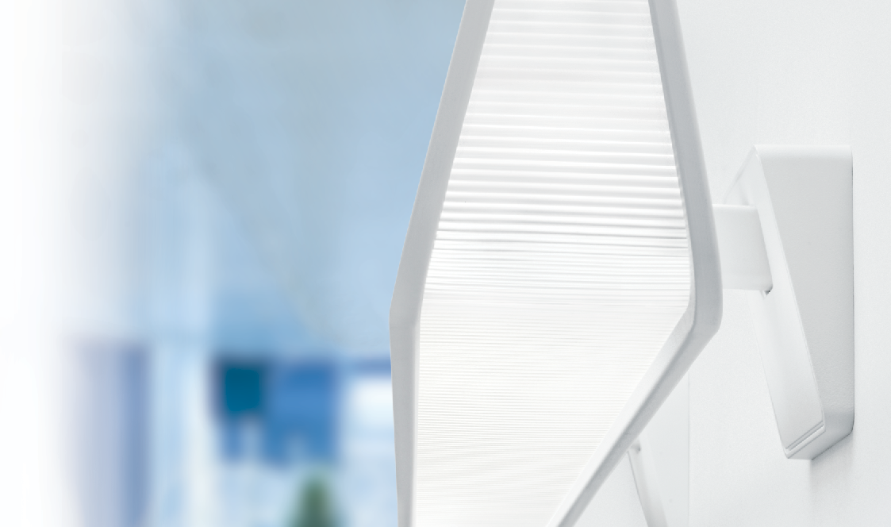
What’s New
Next generation LEDs, boards & drivers
  30-40% higher efficacy, 25-33% energy savings
  86 lm/W with batwing from a 4” aperture
  LEDs run cooler, longer life
New options
  50% higher 3600 lm/4ft lumen
  package, more applications
  Warmer 3000K color temperature
  New emergency battery pack option
  More combination wiring options with dimming
  (Canada) 347V option available
Significant LED luminaire price reductions due to component cost & manufacturing improvements
Notes:
Major upgrade: Greatly improved LEDs & electronics; higher lumen package, warmer color temperature and other options mean new applications. Now priced to challenge fluorescent dimming.

Slide 9
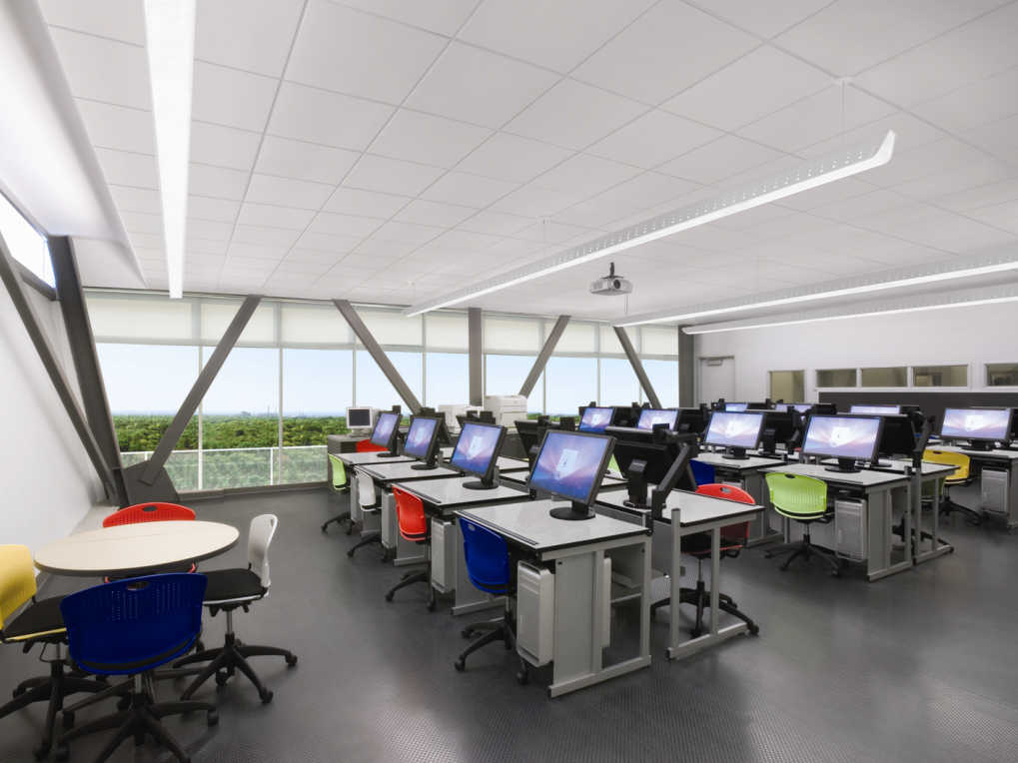
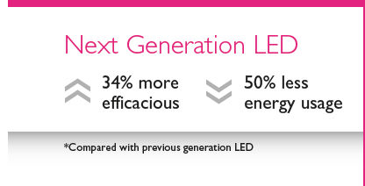
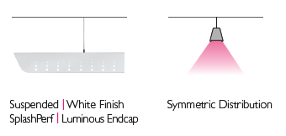

Education
Controlled lighting helps brighten young minds
3000K
25’ x 40’ x 9.5’H
8ft AFF
*On desks
Notes:
A great example of Jump’s strengths. In spite of standard ceiling height and relatively wide fixture spacing, the luminaire delivers plenty of light and extremely even lighting on the work surfaces. The resulting energy density is less than half current recommendations. Brains & beauty.

Slide 10
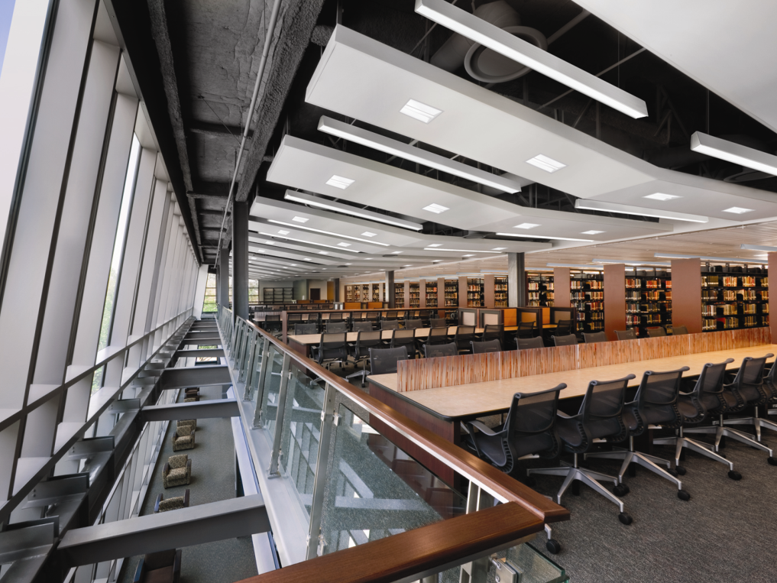

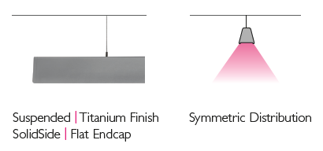
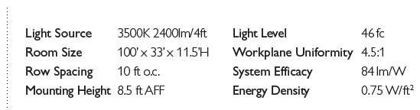
Library
Luminous spaces for study and vertical stack illumination
Notes:
Libraries require abundant sources of light to provide optimal study environments. Jump’s exceptional batwing distribution spreads lighting evenly throughout a library, enabling wider row spacing, which means less luminaires are required, resulting in reduced energy consumption.

Slide 11
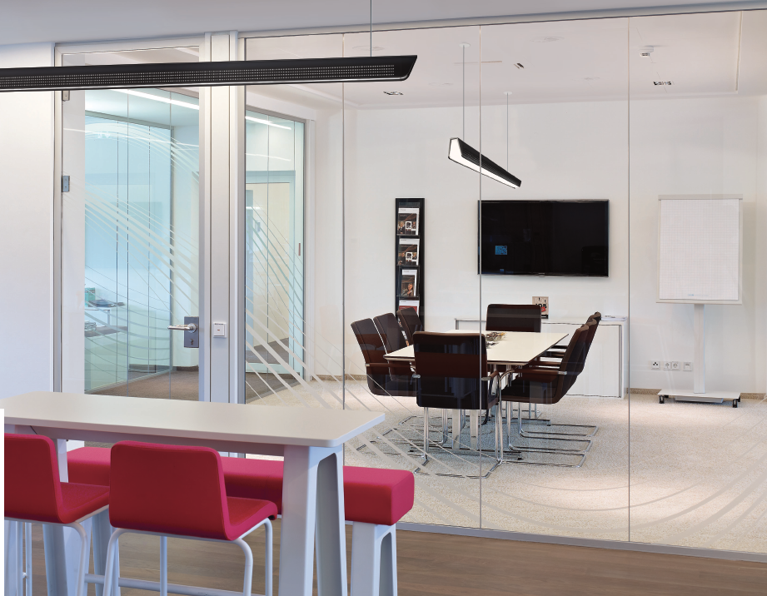

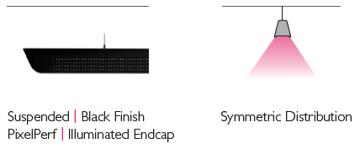
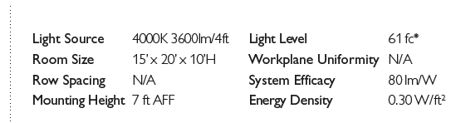
Boardroom
Clean white light without glare for conversation areas
*On boardroom table
Notes:
From boardrooms to open plan cubicle areas, Jump is a perfect solution for bustling environments requiring visual comfort, contemporary design, and maximum energy savings. In this application, Jump’s wide throw and spill light from the surrounding corridors allows the use of a single fixture to provide bright lighting on the boardroom table, tapering off to acceptable levels in the corners of the room. The resulting energy density is exceptionally low.

Slide 12
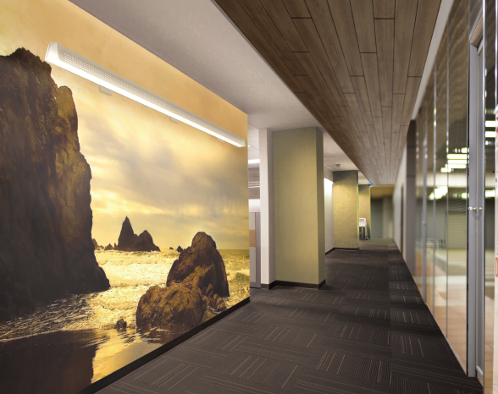
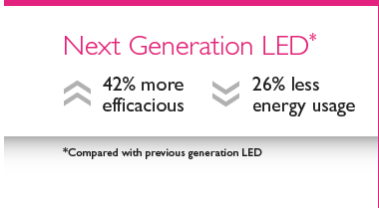
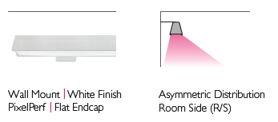

Corridor
Asymmetric meets aesthetic
Notes:
Unlike most competitors, Jump provides the option of a true asymmetric distribution, perfect for corridors. This application demonstrates the greater than 40% improvement in Philips LED technology, particularly striking in this potentially energy-sapping warmer color temperature with asymmetric throw.

Slide 13
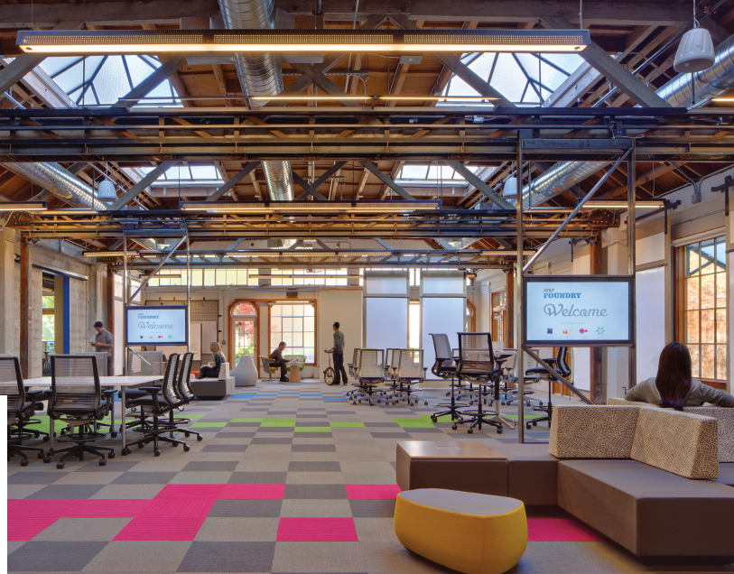

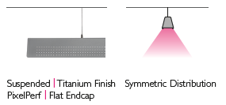
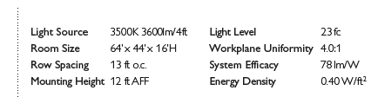
Office
Visual comfort, refined design, minimum energy
Notes:
In this open plan work space, the combination of high ceilings, batwing distribution and a warm color temperature have resulted in amazing light uniformity and a gentle, relaxing luminous environment. All while consuming considerably less than 0.5W/sqft.

Slide 14
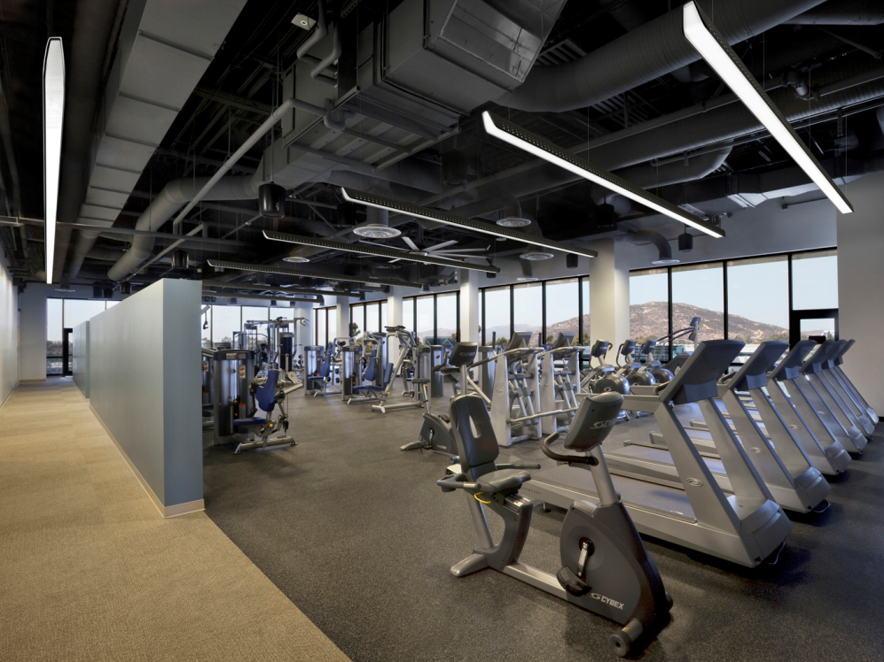
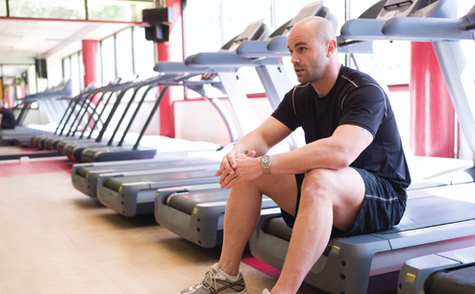
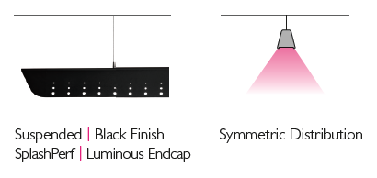
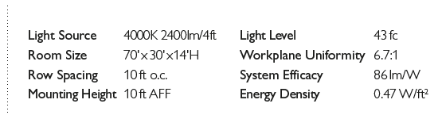
Health
Enhancing people’s environment & well-being
Notes:
Jump integrates well with spaces that have unique or differentiated ceiling layouts without causing interruption to the design of the space. In this application, LED sources provide a lower energy consumption, better luminaire efficiency, as well as superior system efficacy.

Slide 15
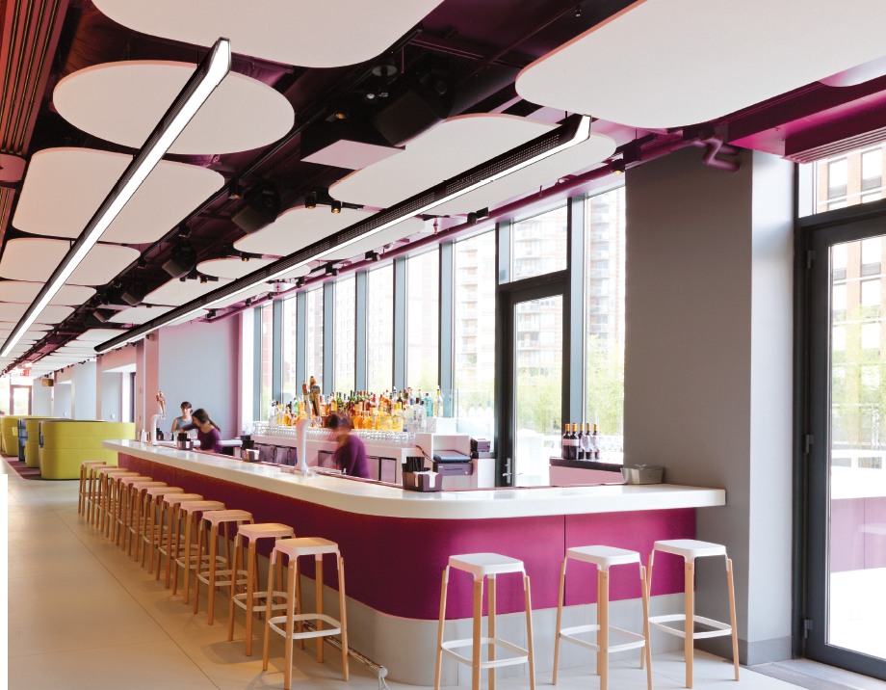
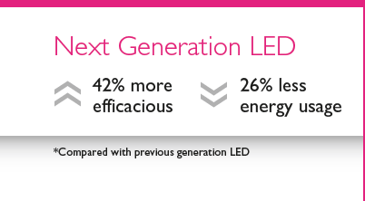
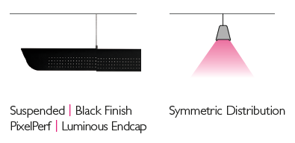

Retail
Design detail & dynamic spaces
*On bar surface
Notes:
In this cafe/bar environment, Jump’s fresh aesthetic contributes to a modern, energetic feel. Energy savings and a warm, comfortable visual experience are simply the icing on the cake.

Slide 16
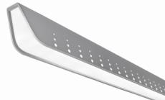

Jump LED Compared
Product |  | Jump | Typical Suspended Slot
Aesthetics
 | Housing | Perf patterns | Solid
 | Standard colors | ü | û
 | Endcap | Luminous, Sculpted, Flat | Flat
Optical control
 | Distribution | Batwing | Teardrop
 | Workplane uniformity / spacing | High | Low
Versions
 | Mount Types | Suspended, Surface, Wall, Cantilever | Suspended, Surface, Wall, Recess
 | Asymmetric | ü | û
LED Light Engine
 | Lumen Packages | 2400, 3600 lm/4ft | 1500, 3000 lm/4ft
 | Efficacy (2000+ lm/4ft) | 86 lm/W | <80 lm/W
 | Color Control | 2.5 Step MCDM | 3.5 Step MCDM
Warranty |  | 5 Year System | 3 Year LEDs
Notes:
There are still very few direct competitors to Jump. The closest overall are slot fixtures which have been suspended, since they have a continuous line of light. However, these types of fixtures have very plain, angular aesthetics and do not match Jump’s lighting performance. Luminaire prices may be lower but since Jump can be spaced wider, then the overall package cost is often higher. Also, efficacy is weak even without a batwing, and Jump provides both asymmetric throw and a higher lumen package to cover more applications.

Slide 17


