Slide 2
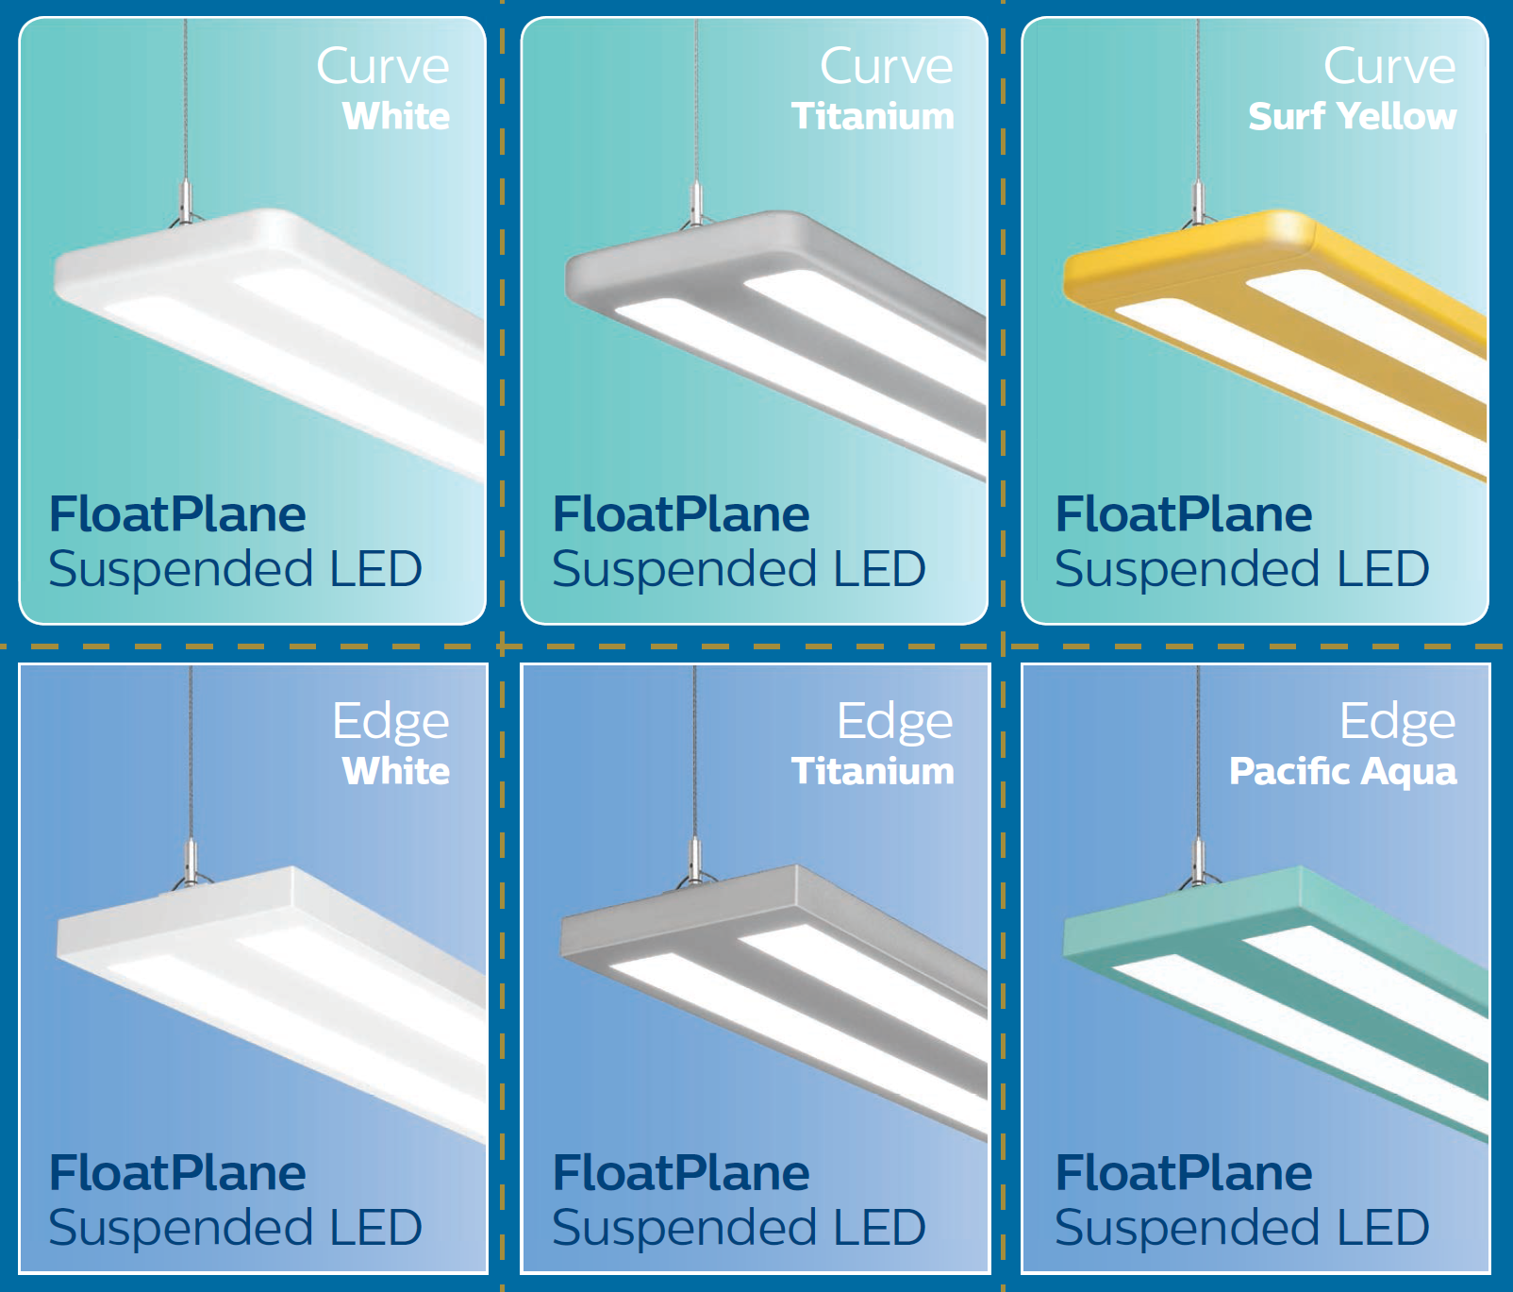
FloatPlane Versions & Finishes

Slide 3
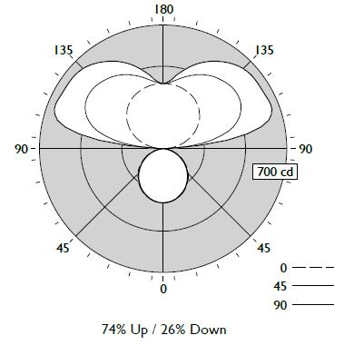
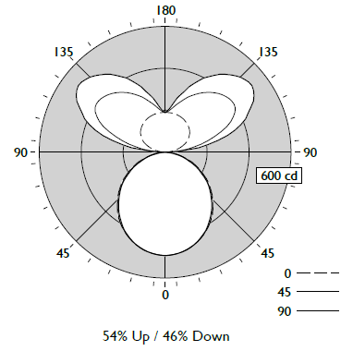
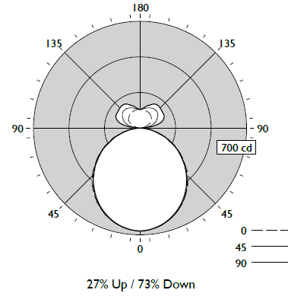
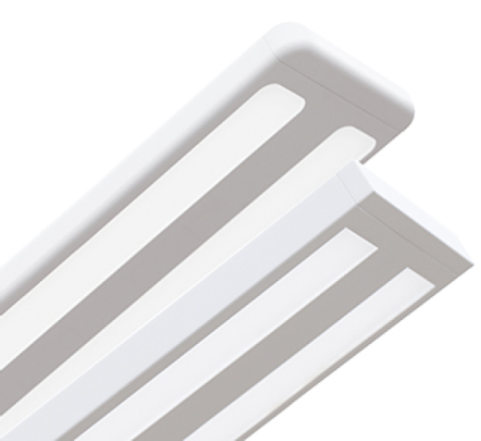
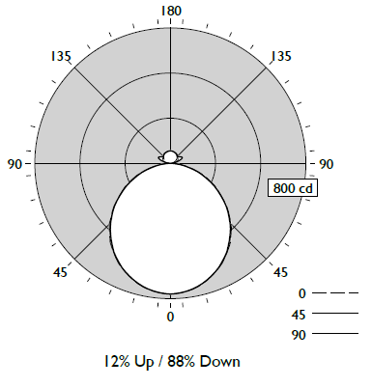
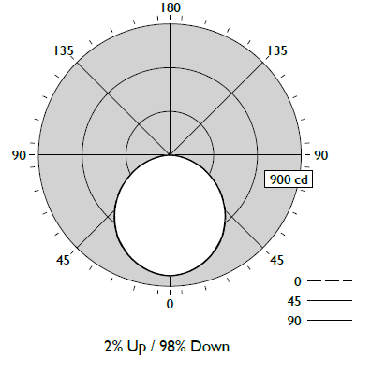
FloatPlane Suspended – Excellent Performance
70% Up (147 LPW)
45% Down (134 LPW)
75% Down (117 LPW)
90% Down (111 LPW)
100% Down (107 LPW)

Slide 4
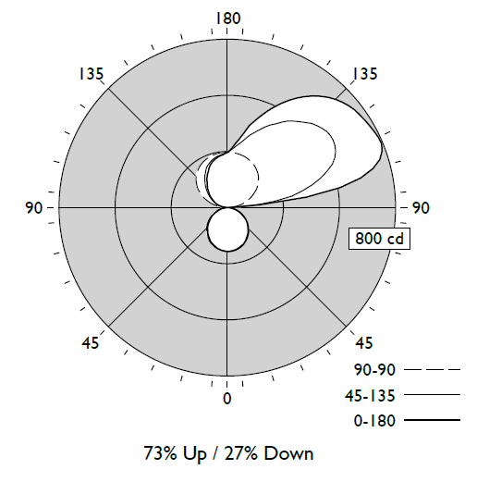
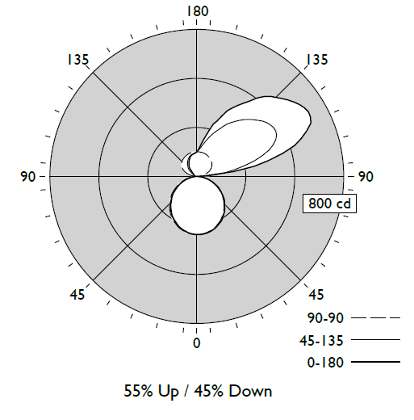
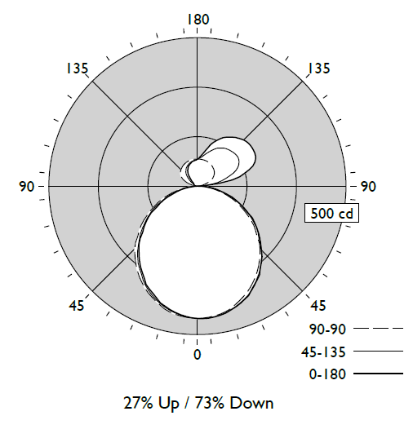
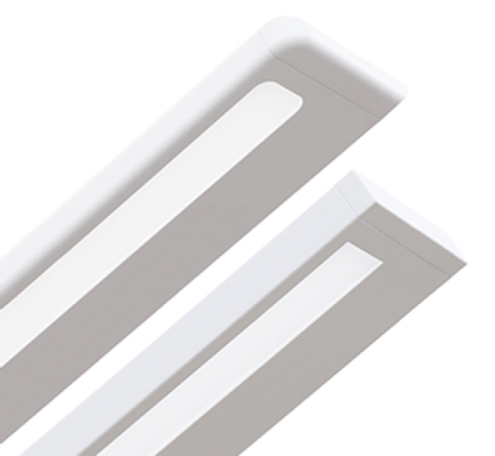
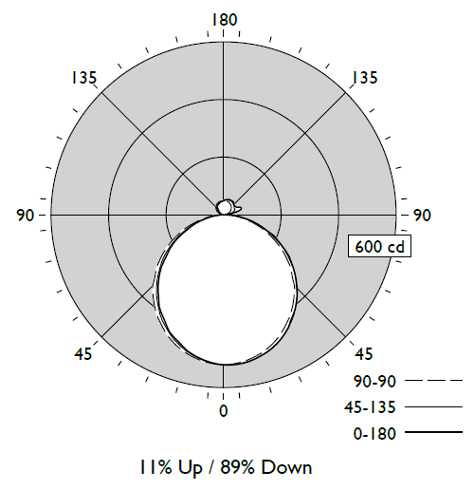
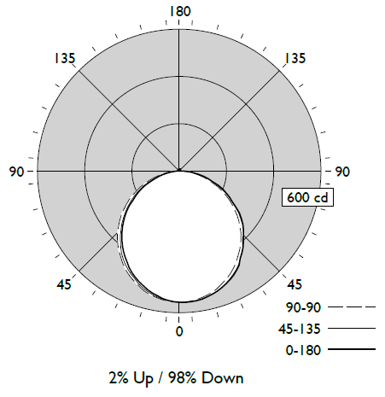
FloatPlane Wall – Excellent Performance
70% Up (134 LPW)
45% Down (122 LPW)
75% Down (106 LPW)
90% Down (102 LPW)
100% Down (98 LPW)

Slide 5
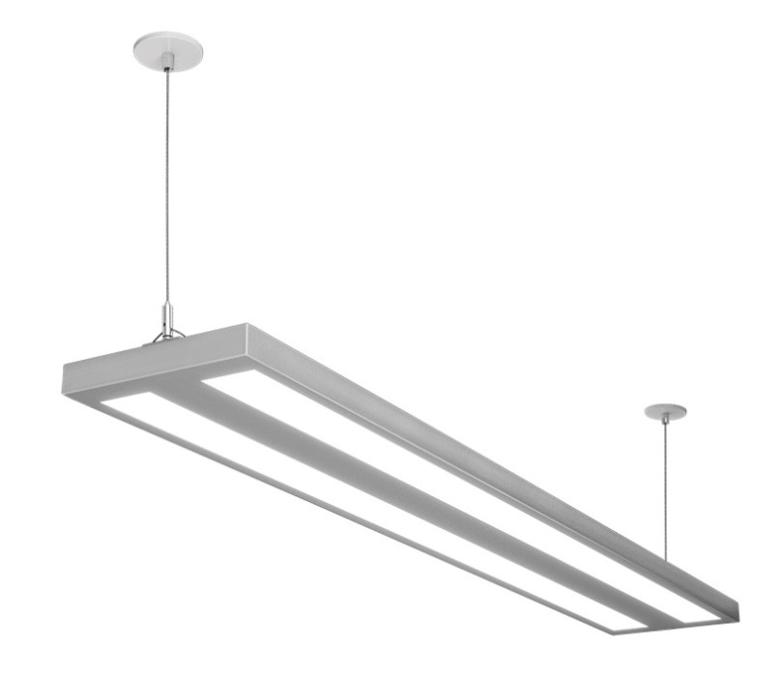
FloatPlane Key Features
Sleek, Sporty Design
Edge (squared) & Curve (rounded)
Dual windows, smooth luminance
1.2” tall x 8” wide
Right Price
25% lower than Ledalite LED linear light-guide products
Lower than fluorescent linear performance e.g. Sync
Great Performance
Wide throw upper batwing distribution
Smooth, controlled brightness in lower lens
Suspended: Up to 147 LPW, Wall: Up to 134 LPW
Design Lights Consortium (DLC) listed
Fast to Install
Suspended sling mount
Wiring access panel
Variable wall mount
Actual contractor comment:
“FloatPlane is by far the easiest to install linear suspended luminaire that I’ve come across.”

Slide 6
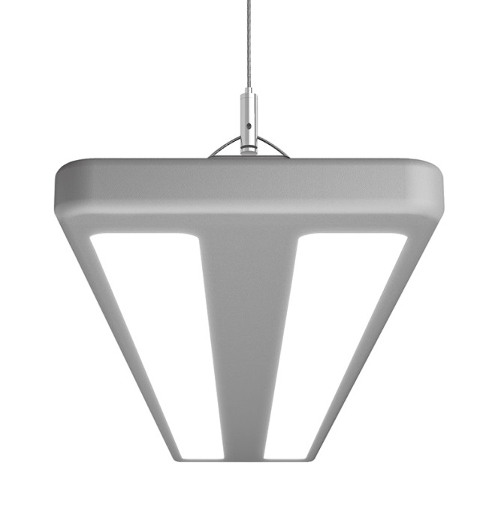
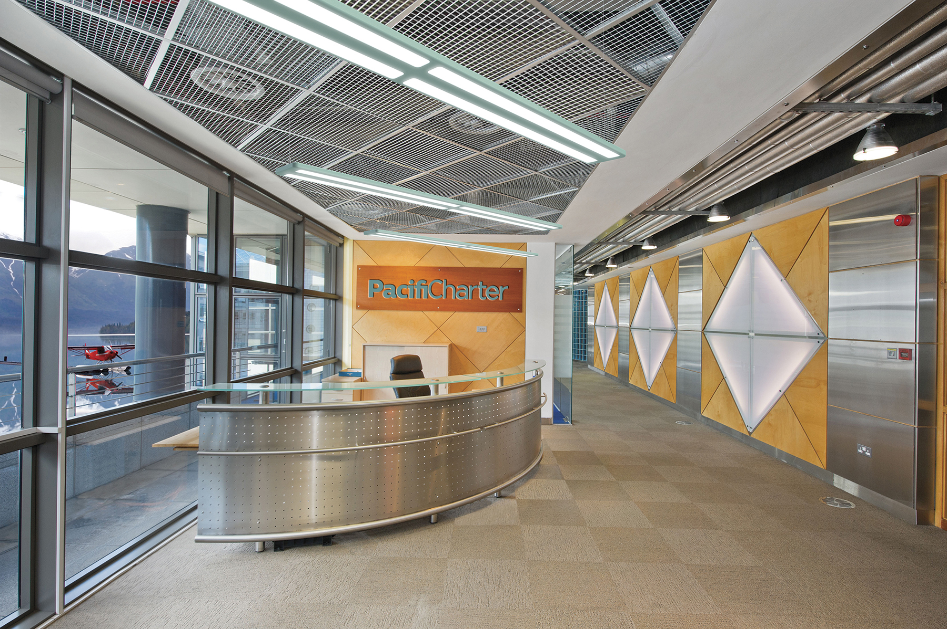
FloatPlane Applications
Ideal for:
Offices
Schools
Libraries
Lobbies
Corridors (wall mount)
Retail

Slide 7
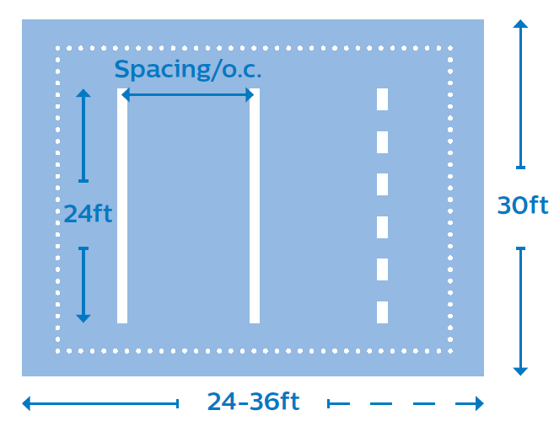
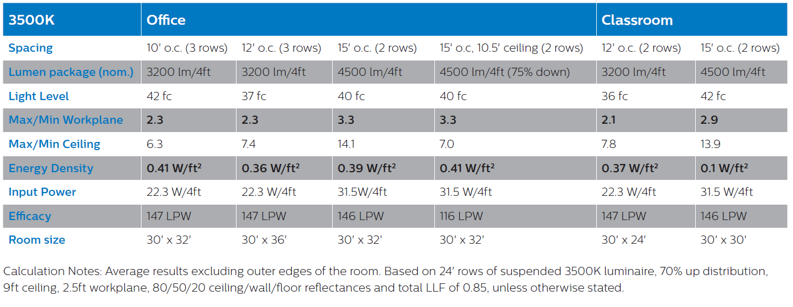
FloatPlane Applications

Slide 8
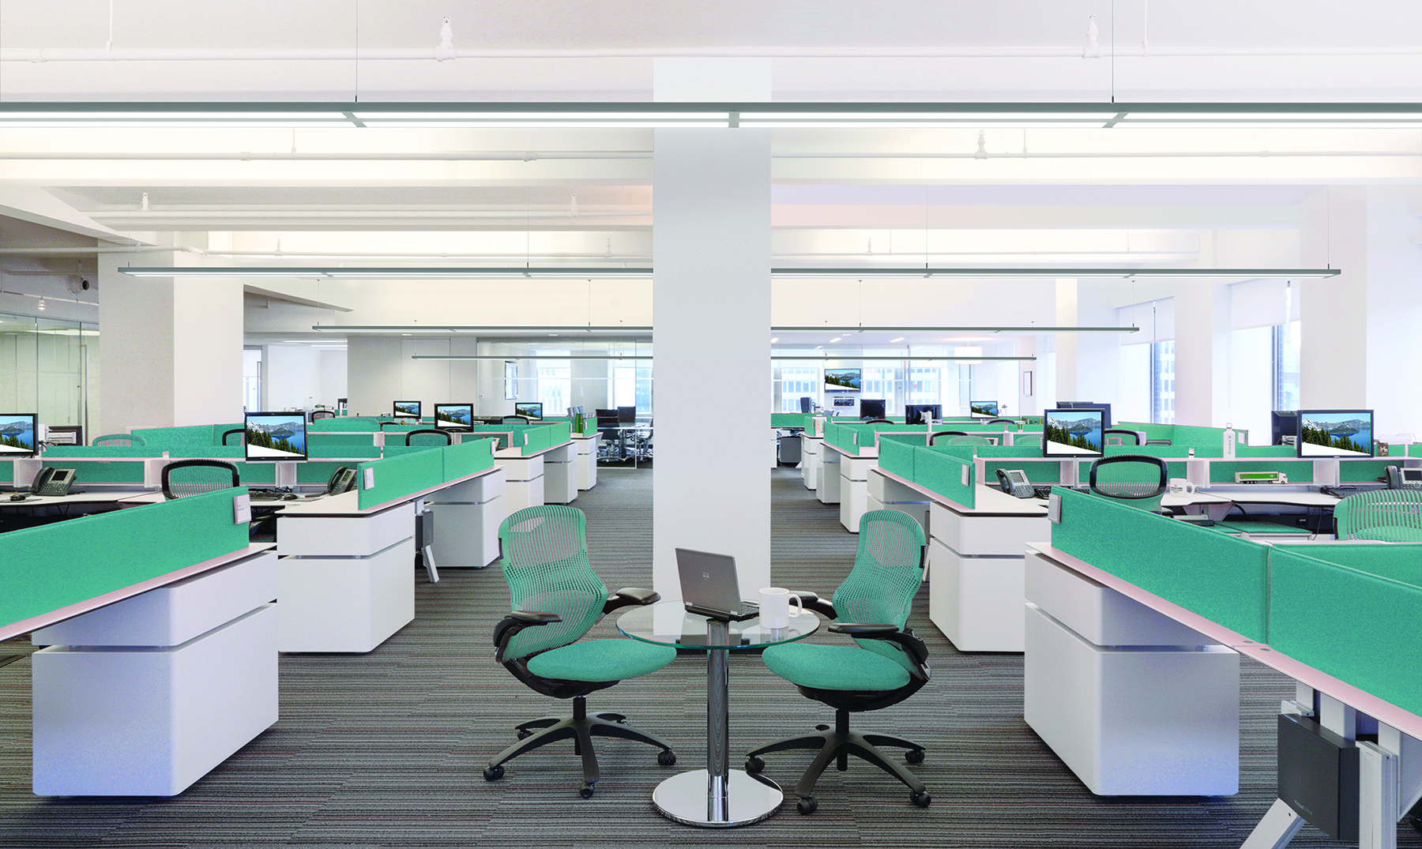
Office
20% fewer fixtures
40% energy savings

Slide 9
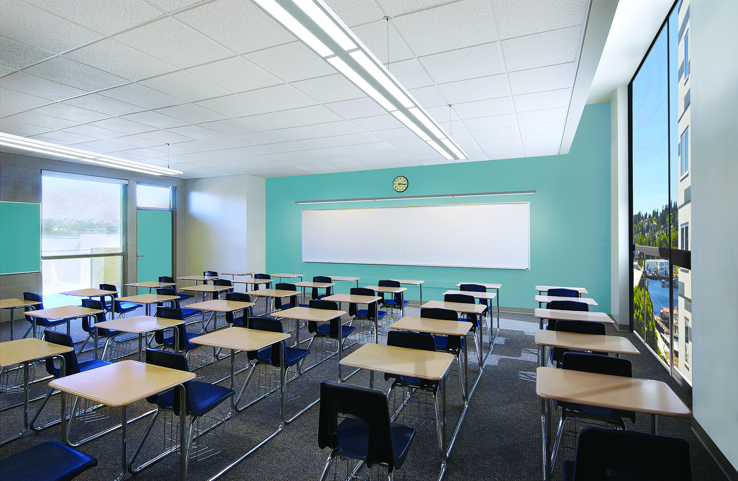
Education
53% energy savings

Slide 10
High / Open Ceiling
25% fewer fixtures
35% energy savings

Slide 11
FloatPlane Certifications
Design Lights Consortium Standard and Premium
(coming end of October 2019, suspended models only)
IESNA LM-79 and LM-80 tested
Lumen Maintenance
According to IES TM-21-11
Reported Method
L₉₀ (10k) 58,000 hrs
Projected Method
L₈₀ (10k) 116,000 hrs

Slide 12
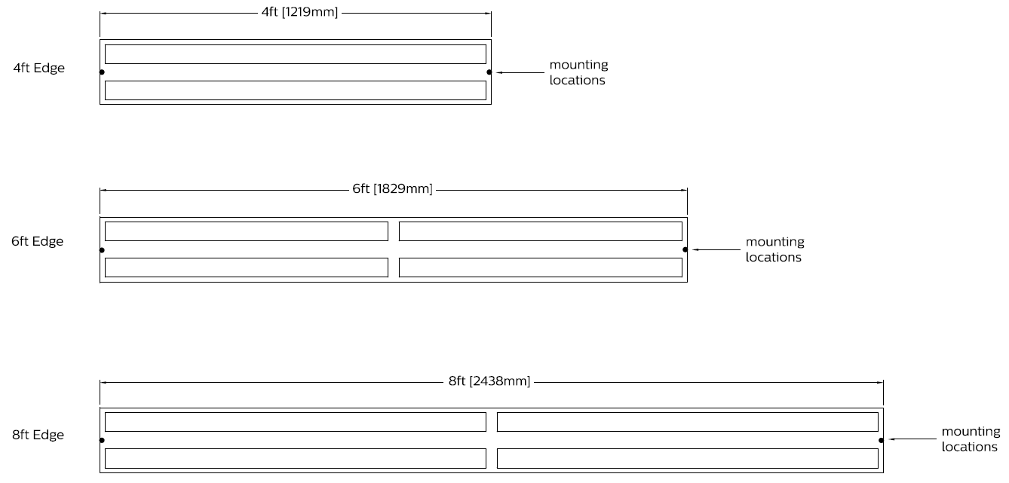
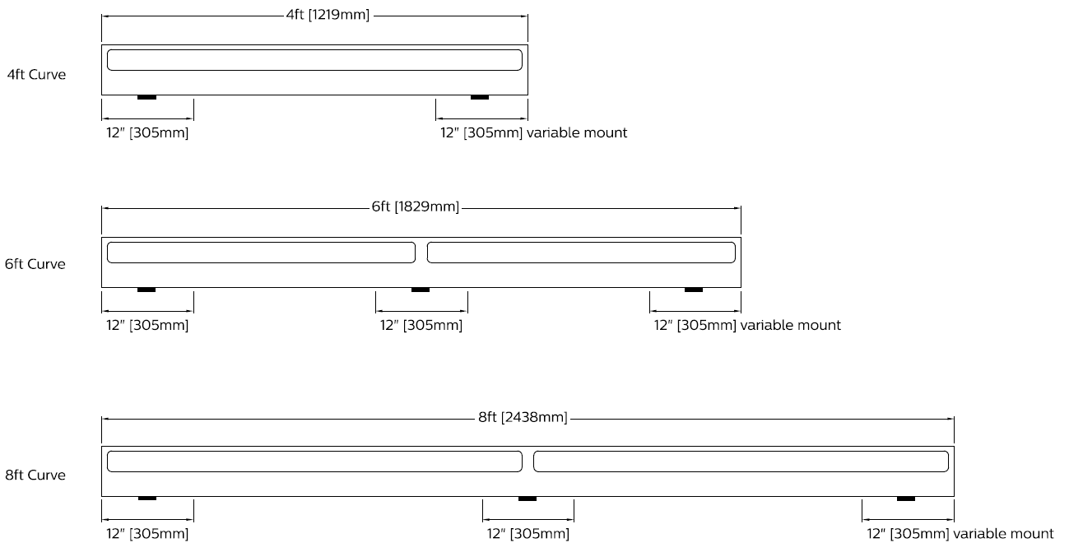
Modules
Edge Suspended
Curve Wall

Slide 13
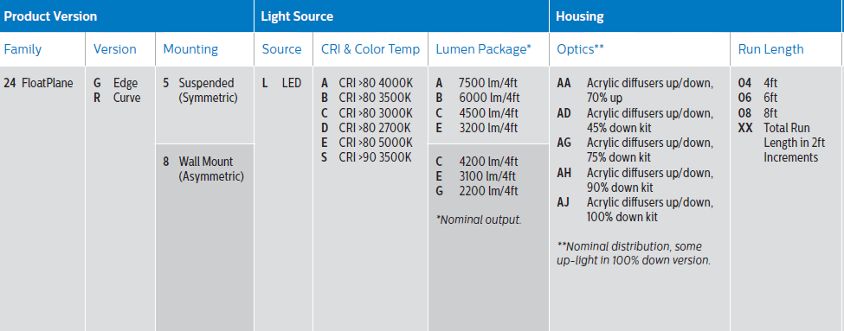
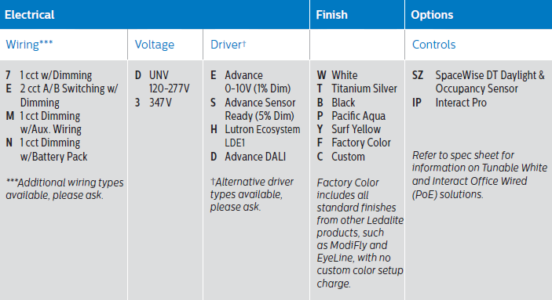
FloatPlane Order Guide
Sensors + Controls available in Suspended versions

